Slide 1


Slide 2
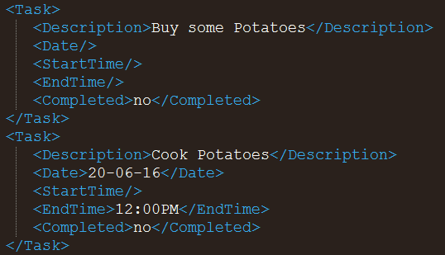
Storage
Extensible Markup Language (XML)
Simple structure
Easy to edit

Slide 3



Storage

Slide 4

What’s next?
Colour scheme
Change Fonts
Mobile App
Notifications
Modular
Encryption
Web App
Scalable
Autocomplete
More

Slide 5

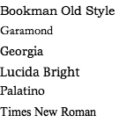
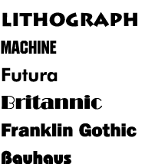
What’s next?
Customizability
Colour scheme
Font

Slide 6

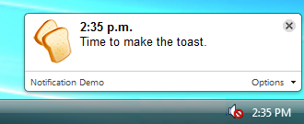




What’s next?
Notifications
Encryption

Slide 7
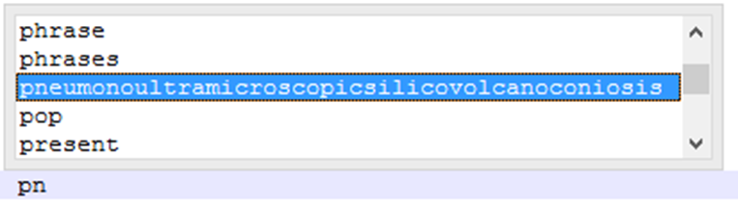
What’s next?
Autocomplete & Autocorrect
Personalized

Slide 8
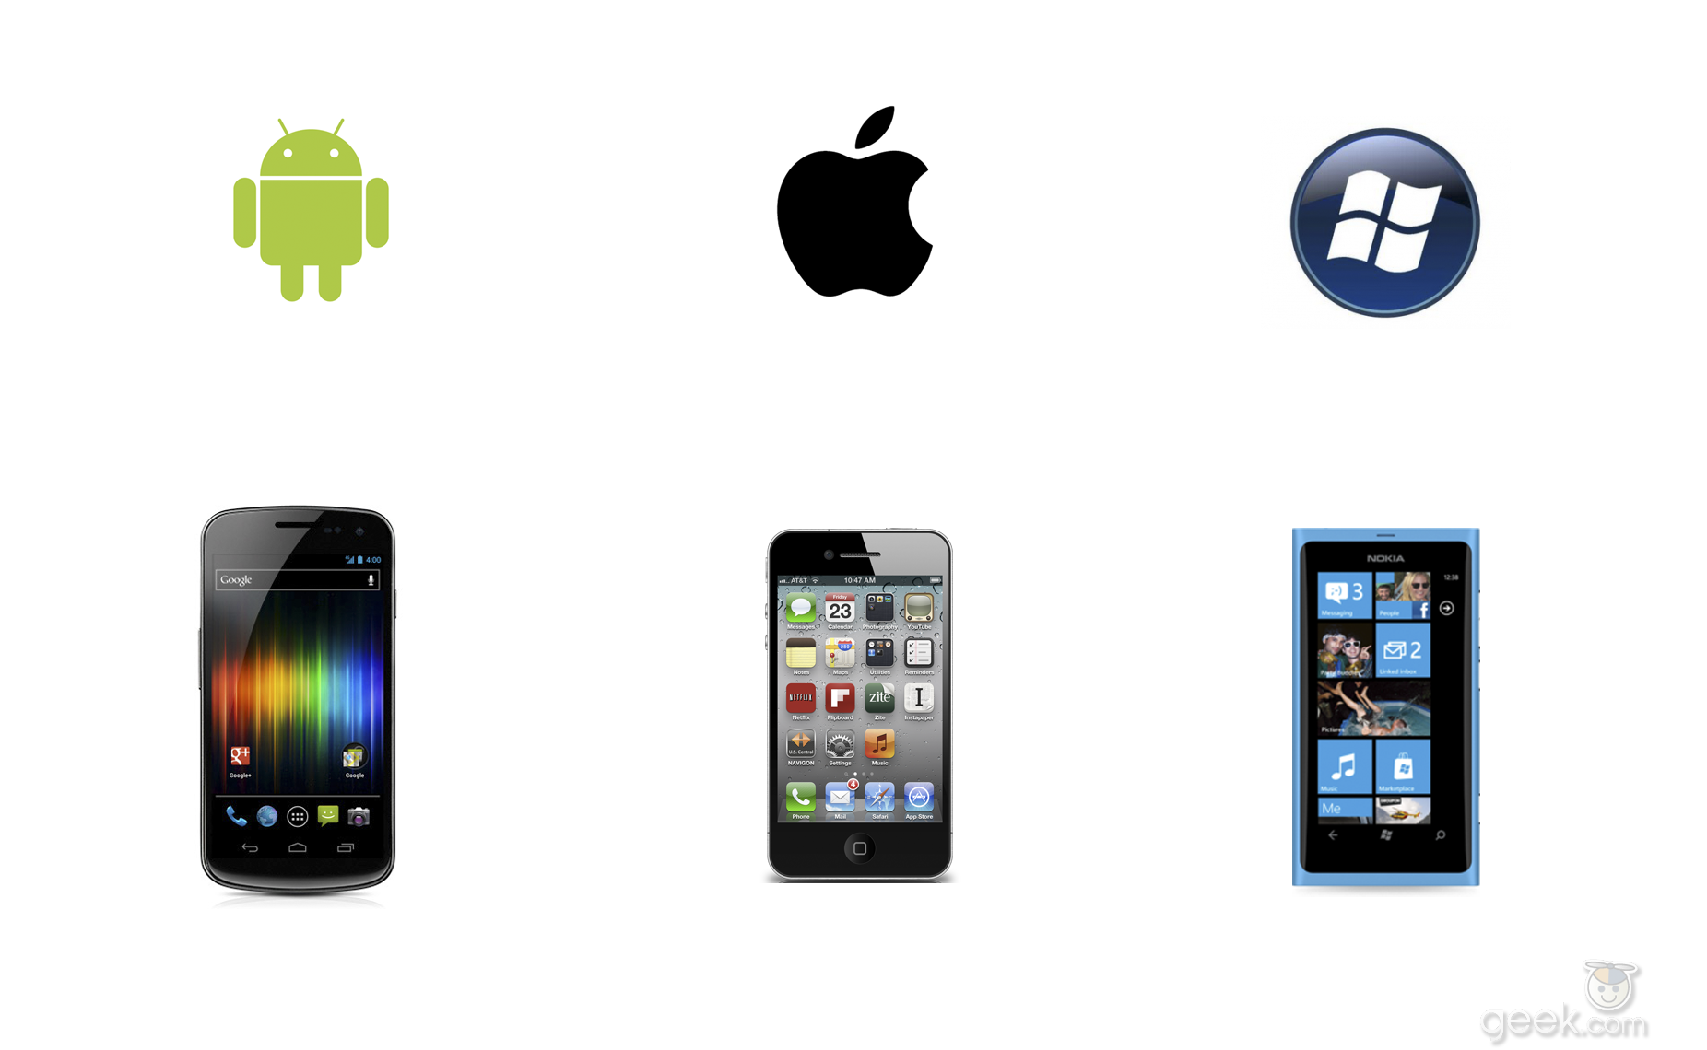

What’s next?
Mobile support
Web Application

Slide 9
Questions?

